Slide 1
Introduction to object- oriented programming
Chapter - 1

Slide 2
Unstructured Programming
In Unstructured Programming, the code is written as a single whole block. The whole program is taken as a single unit. It is harder to do changes in the program. This paradigm was used in earlier versions of BASIC, COBOL, and FORTRAN. Unstructured programming languages have a limited number of data types.

Slide 3
Structured Programming
In Structured Programming, the code is divided into functions or modules. It is also known as modular programming. Modules or functions are a set of statements which performs a sub task. As each task is a separate module, it is easy for the programmer to test and debug. It is also easy to do modifications without changing the whole program. When changing the code, the programmer has to concentrate only on the specific module. C language and Pascal are some examples of Structural Programming languages.

Slide 4
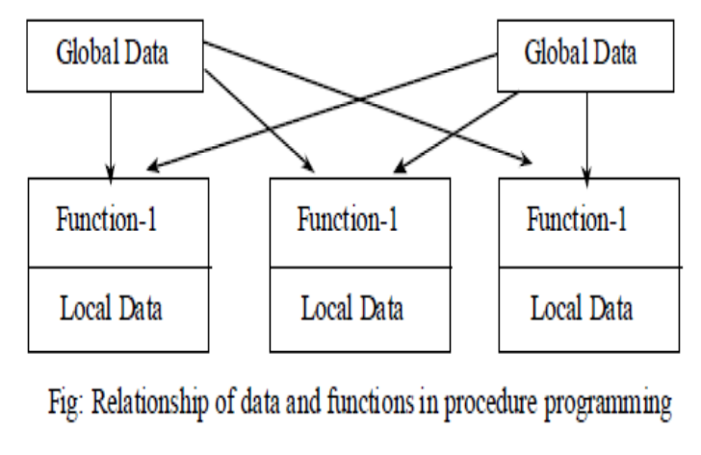

Slide 5
Limitation of structured programming
Structured programming focus on functions rather than data.
In a multi-function program, many important data are placed as global so that they may be used by all the functions. In large program, it is very difficult to identify what data is used by which function, which creates error.
Lack of Encapsulation
In structured programming, programs will be longer. The same code will appear in more than one location so that there is greater chance of errors, the testing will be lengthy.
Structured programming don’t model the real world problems.
Another problem with Structured programming is the difficulty of creating new data type.

Slide 6
Object Oriented Language
The fundamental idea behind Object Oriented Language is to combine into a single unit both data and the functions that operate on that data. Such a unit is called an object.
An object function called member function typically provide the only way to access its data.
We can’t access the data directly. The data is hidden, so it is safe from accidental alteration.
Data and its functions are said to be encapsulated into a single unit.
OOPs consists of number of object which communicate with each other by calling one another’s member function.

Slide 7
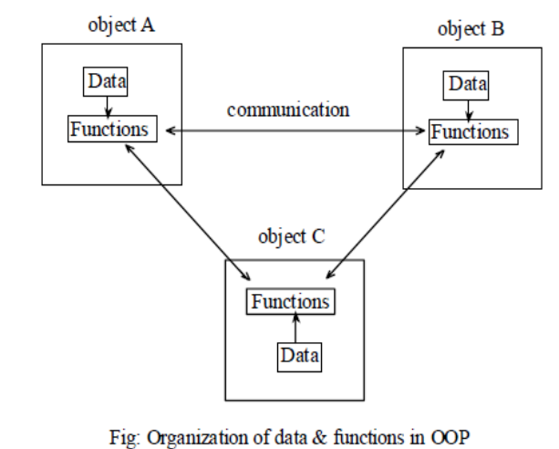

Slide 8
Features of Object Oriented Language
Features of Object Oriented Language are given below:

Slide 9
1. Class:
A class is a user-defined data type. It consists of data members and member functions, which can be accessed and used by creating an instance of that class. It represents the set of properties or methods that are common to all objects of one type. A class is like a blueprint for an object.
For Example: Consider the Class of Cars. There may be many cars with different names and brands but all of them will share some common properties like all of them will have 4 wheels, Speed Limit, Mileage range, etc. So here, Car is the class, and wheels, speed limits, mileage are their properties.

Slide 10
Example
Create a class called "MyClass":
class MyClass
{ // The class
public: // Access specifier
int myNum; // Attribute (int variable)
string myString; // Attribute (string variable)
};

Slide 11
2. Objects:
It is a basic unit of Object-Oriented Programming and represents the real-life entities. An Object is an instance of a Class. When a class is defined, no memory is allocated but when it is instantiated (i.e. an object is created) memory is allocated. An object has an identity, state, and behavior. Each object contains data and code to manipulate the data. Objects can interact without having to know details of each other’s data or code, it is sufficient to know the type of message accepted and type of response returned by the objects.
For example “Dog” is a real-life Object, which has some characteristics like color, Breed, Bark, Sleep, and Eats.

Slide 12
Example
Create an object called "myObj" and access the attributes:
class MyClass { // The class
public: // Access specifier
int myNum; // Attribute (int variable)
string myString; // Attribute (string variable)
};
int main() {
MyClass myObj; // Create an object of MyClass
// Access attributes and set values
myObj.myNum = 15;
myObj.myString = "Some text";
// Print attribute values
cout << myObj.myNum << "\n";
cout << myObj.myString;
return 0;
}

Slide 13
3. Inheritance:
As the name suggest, is the properties of an existing class to get new class. The common properties is defined in the base class and other class can be derived which has similar characteristics and new features can be added to the derived class. The main advantage of using inheritance in OOPs is it helps in reducing the code size. This provides the users the important term called reusability.

Slide 14
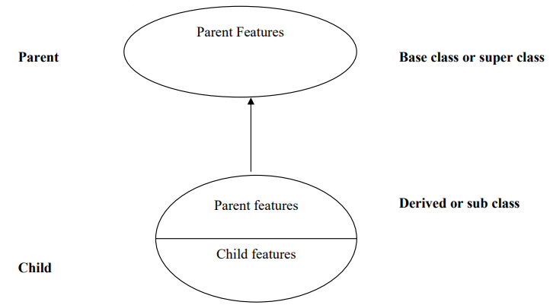

Slide 15
4. Reusability:
Once a class has been written, created and debugged, it can be distributed to other programs for use in their own programs, this is called reusability. A program can take an existing class, and without modifying it, add additional features and capabilities to it. This is done by deriving a new class from the base class. The new class will inherit the capabilities, features of old class, but it is also free to add new features of its own. This time saving features optimizes code helps in gaining secured application and facilitates easier maintenance on the application program.

Slide 16
5. Data Encapsulation:
It is the mechanism that binds together function and data so that both are safe from outside misuse. In OOPs, data and function may be combined in such a way that black box (protective wall) is created. The data are visible only to the member function called data hiding.

Slide 17
6. Polymorphism:
The word “Polymorphism” is derived from the Greek word poly-morphos which means many forms. Polymorphism is an ability to take more than one form. It is similar to that one person acting differently according to the situation. An operation may exhibit different behavior in different instances that depends upon the types of data used in the program. The example of polymorphism is operator overloading.

Slide 18
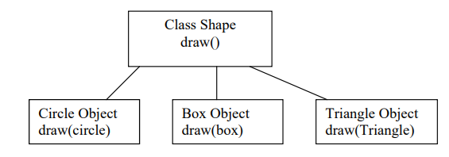

Slide 19
7. Methods and message passing:
Methods represents a set of instructions to perform the desire operation. Method can be written by the user to perform his operation. Method is also called function. We can pass the information through the methods as its parameter. So message passing is the way to pass variables from the methods.

Slide 20
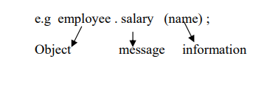

Slide 21
Difference between Data encapsulation and Data Abstraction:
Abstraction
Encapsulation
1) It is a process of hiding unimportant data, revealing only the important ones.
2) It is basically to hide complexity of implementation & provide ease of access to the users.
3) E.g. TV / Laptop: In TV we only know to change the channel, increase/decrease volume, on/off TV. But we don’t know about video detection, cathode ray tube etc.
It is a process of hiding the data for purpose of protection.
It is basically to bind data members & member function into a single unit.
E.g. while sending the message to our friend we will encrypt the message, so that other can’t understand it.

Slide 22
Advantages of OOPs
• Making the use of inheritance, redundant code is eliminated and the existing class is extended.
• Through data hiding, programmer can build secure programs that cannot be invaded by code in other pats of the program.
• It is possible to have multiple instances of an object to co-exist without any interference.
• System can be easily upgraded from small to large systems. • Software complexity can be easily managed.
• Message passing technique for communication between objects makes the interface description with external system much simpler.
• Aids trapping in an existing pattern of human thought into programming.
• Code reusability is much easier than conventional programming languages

Slide 23
Disadvantages of OOP
Steeper learning curve: OOP introduces complex concepts like classes, objects, inheritance, and polymorphism, making it harder for new programmers to grasp and apply them effectively.
Increased complexity: OOP's emphasis on modularity and code organization can make larger projects more challenging to understand and maintain.
Performance overhead: OOP languages often have a performance cost compared to procedural languages due to the additional abstraction layers introduced by objects and encapsulation.
Dependency management: Inheritance and code reuse in OOP can create interdependencies among classes, making it difficult to manage changes and maintain overall functionality.
Overuse of inheritance: Improper use of inheritance can lead to complex class hierarchies and tightly coupled classes, making code maintenance and modifications more difficult in the future.

Slide 24
Application of oops
Real-Time System design
Hypertext and Hypermedia
AI Expert System
Office automation System
Object-oriented database
Client-server system

Slide 25
// Your First C++ Program
#include <iostream>
//using namespace std;
int main()
{
std::cout << "Hello World!";
return 0;
}

Slide 26
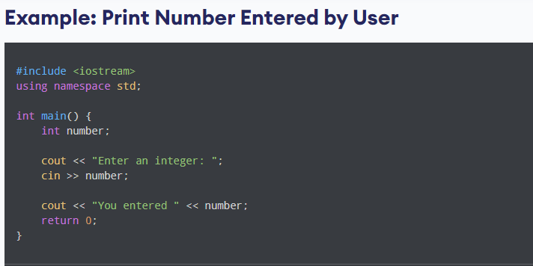

Slide 27
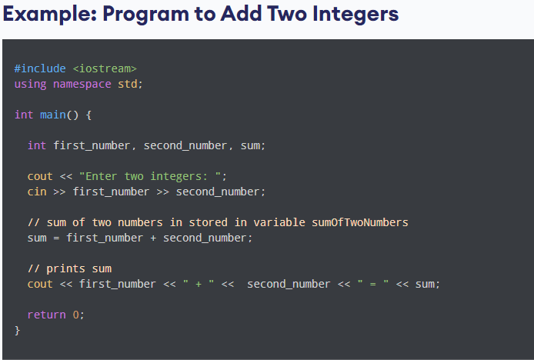

Slide 28
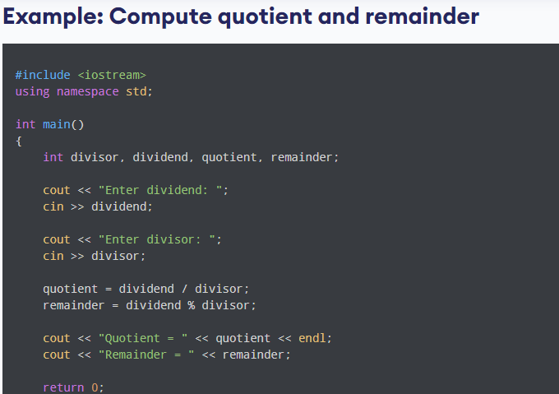

Slide 29
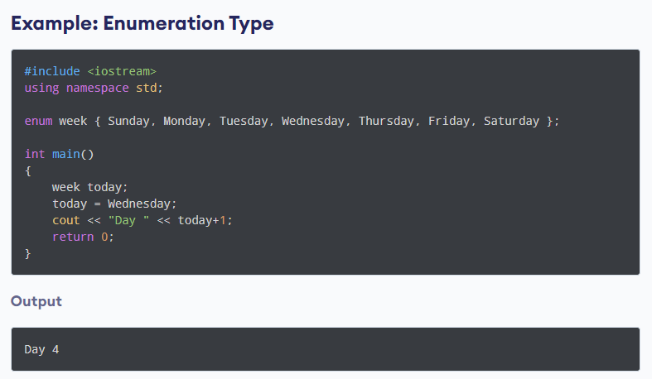

Slide 30
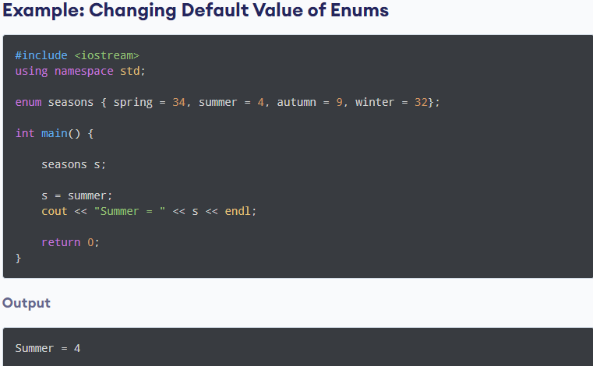

Slide 31
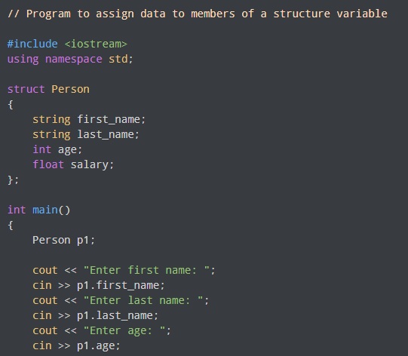

Slide 32
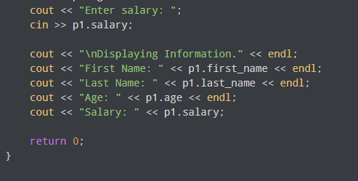

Slide 33
#include <iostream>
using namespace std;
struct Person {
string first_name;
string last_name;
int age;
float salary;
// member function to display information about the person
void display_info() {
cout << "First Name: " << first_name << endl;
cout << "Last Name: " << last_name << endl;
cout << "Age: " << age << endl;
cout << "Salary: " << salary << endl;
}
};

Slide 34
int main() {
Person p1;
cout << "Enter first name: ";
cin >> p1.first_name;
cout << "Enter last name: ";
cin >> p1.last_name;
cout << "Enter age: ";
cin >> p1.age;
cout << "Enter salary: ";
cin >> p1.salary;
// display information using member function
cout << "\nDisplaying Information." << endl;
p1.display_info();
return 0;
}

Slide 35
// C++ program to illustrate the use of union in C++
#include <iostream>
using namespace std;
// Creating a union
union geek {
// Defining data members
int age;
char grade;
float GPA;
};

Slide 36
int main()
{
// Defining a union variable
union geek student1;
// Assigning values to data member of union geek and
// printing the values of data members
student1.age = 25;
cout << "Age : " << student1.age << endl;
student1.grade = 'B';
cout << "Grade : " << student1.grade << endl;
student1.GPA = 4.5;
cout << "GPA : " << student1.GPA << endl;
return 0;
}

